Slide 1
RURAL HEALTH UNIT FOR PERSON WITH Disabilities
VALEN JUSTINE IAN
BSIT 2-B

Slide 2
INTRODUCTION
Persons with Disabilities (PWDs) in rural areas often face significant barriers in accessing essential healthcare services, including limited mobility, lack of accessible facilities, and inadequate health record management. To bridge this gap, the Rural Health Unit (RHU) for PWD Application has been developed as a digital tool to streamline health services, promote inclusivity, and ensure that the unique needs of PWDs are met with care and efficiency.

Slide 3
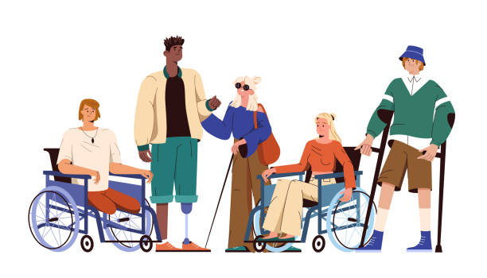
RELEVANCE/PURPOSE
Improves health record management by maintaining up-to-date, accessible digital profiles for PWDs.
Facilitates faster service delivery by enabling RHU staff to monitor appointments, medications, and follow-ups efficiently.
Enhances inclusivity by ensuring that healthcare programs are more responsive to the unique needs of PWDs.
Supports data-driven decision-making by providing reliable statistics for planning and implementing health initiatives.

Slide 4
STAKEHOLDERS
Nurse:
Used the system to access the resident/patient records.
To manage and monitor the checkups
Doctor:
Manage the users using the system
To add, update, and delete records
Monitoring the user logs
To Print Patient Diagnosis

